Slide 1


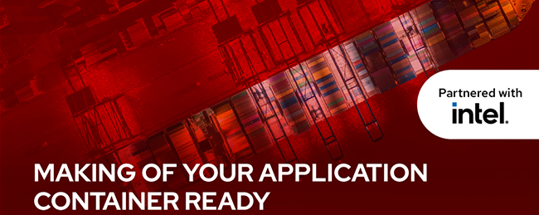

A Journey through expertise...
LEAP
Academy

Slide 2

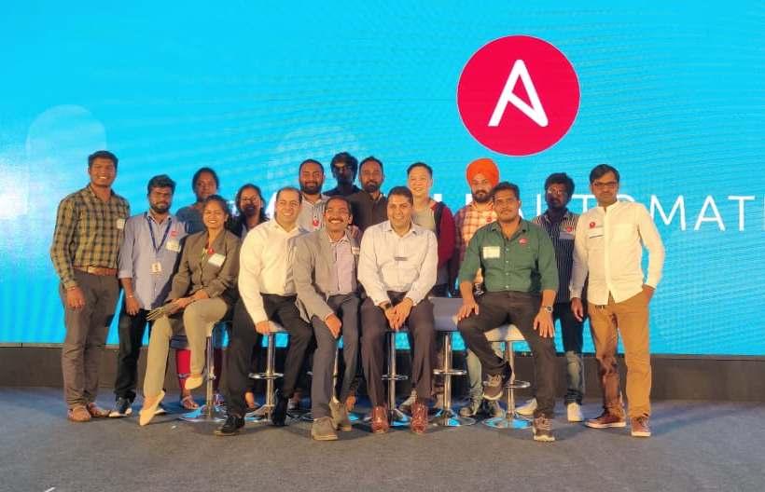

@TechProdevans
Deepak Mishra & Team
(CEO and Founder of Prodevans Technologies)
Ajay E
(Solution Architect, Prodevans Red Hat One Team)

Slide 3
AGENDA
Openshift Architecture & Core pieces
Overview of Operators
Overview of Openshift 4
Overview of Container Native Storage
Openshift 4 Administration
Setup Infrastructure Nodes in Openshift

Slide 4
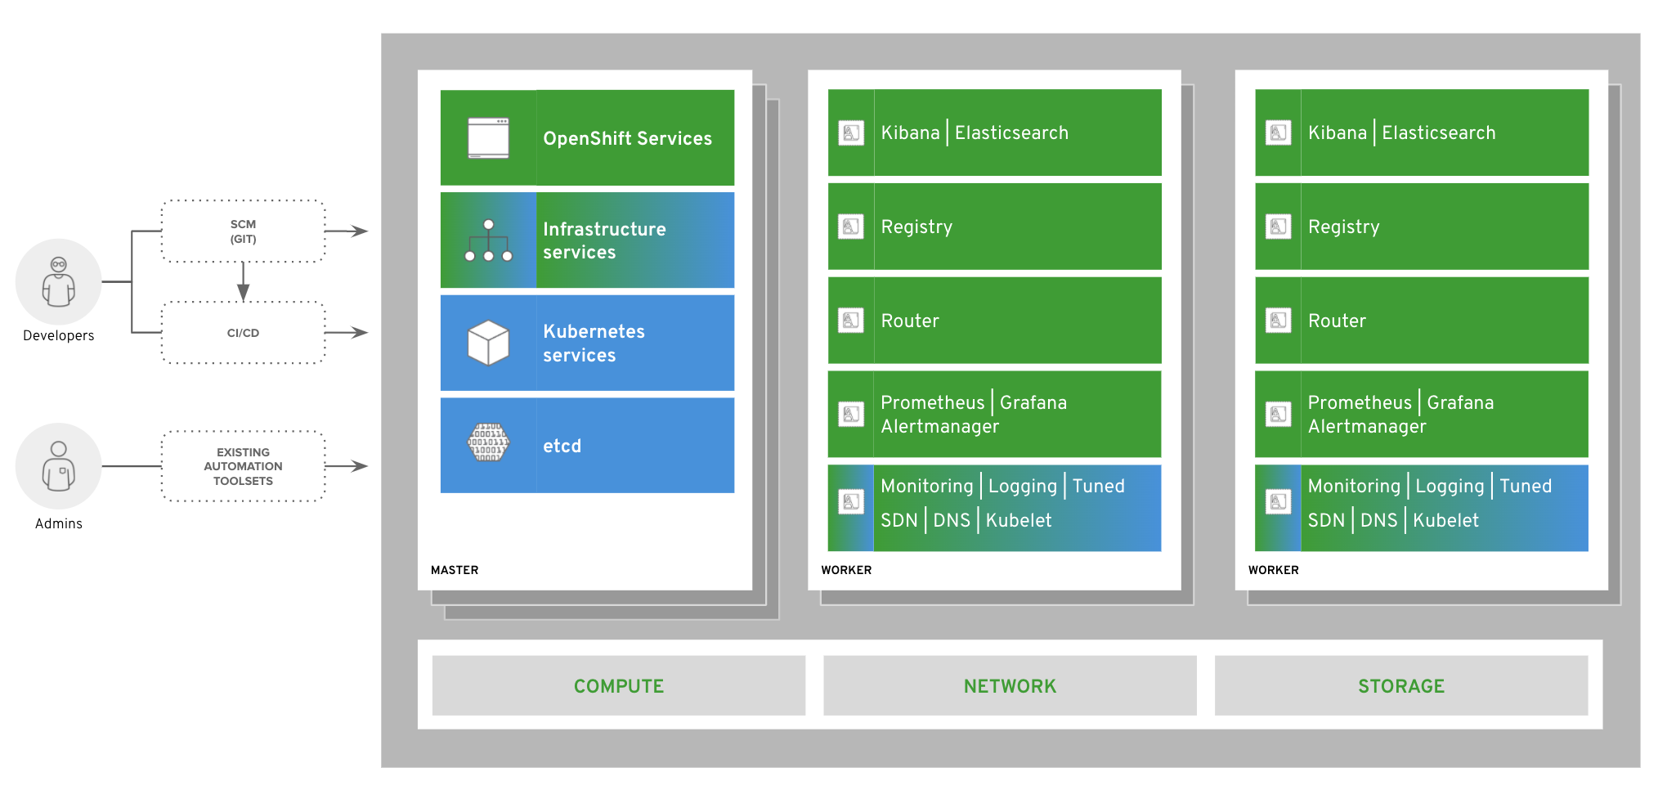
Openshift - High Level Architecture

Slide 5
OpenShift - Core Components
Pod
Build config
Deployment config
Image streams
Services
Routes
Secrets
Replication Controller
Service account
RBAC
Persistent Volume
Persistent Volume Claim
Templates
Resource Quota
Limit Range
Statefulset pods
Config maps
SCC

Slide 6
Pod
Build config
Deployment config
Image streams
Services
Routes
Secrets
Replication Controller
Service account
RBAC
Persistent Volume
Persistent Volume Claim
Templates
Resource Quota
Limit Range
Statefulset pods
Config maps
SCC
How can I manage all Openshift Core Components ?

Slide 7


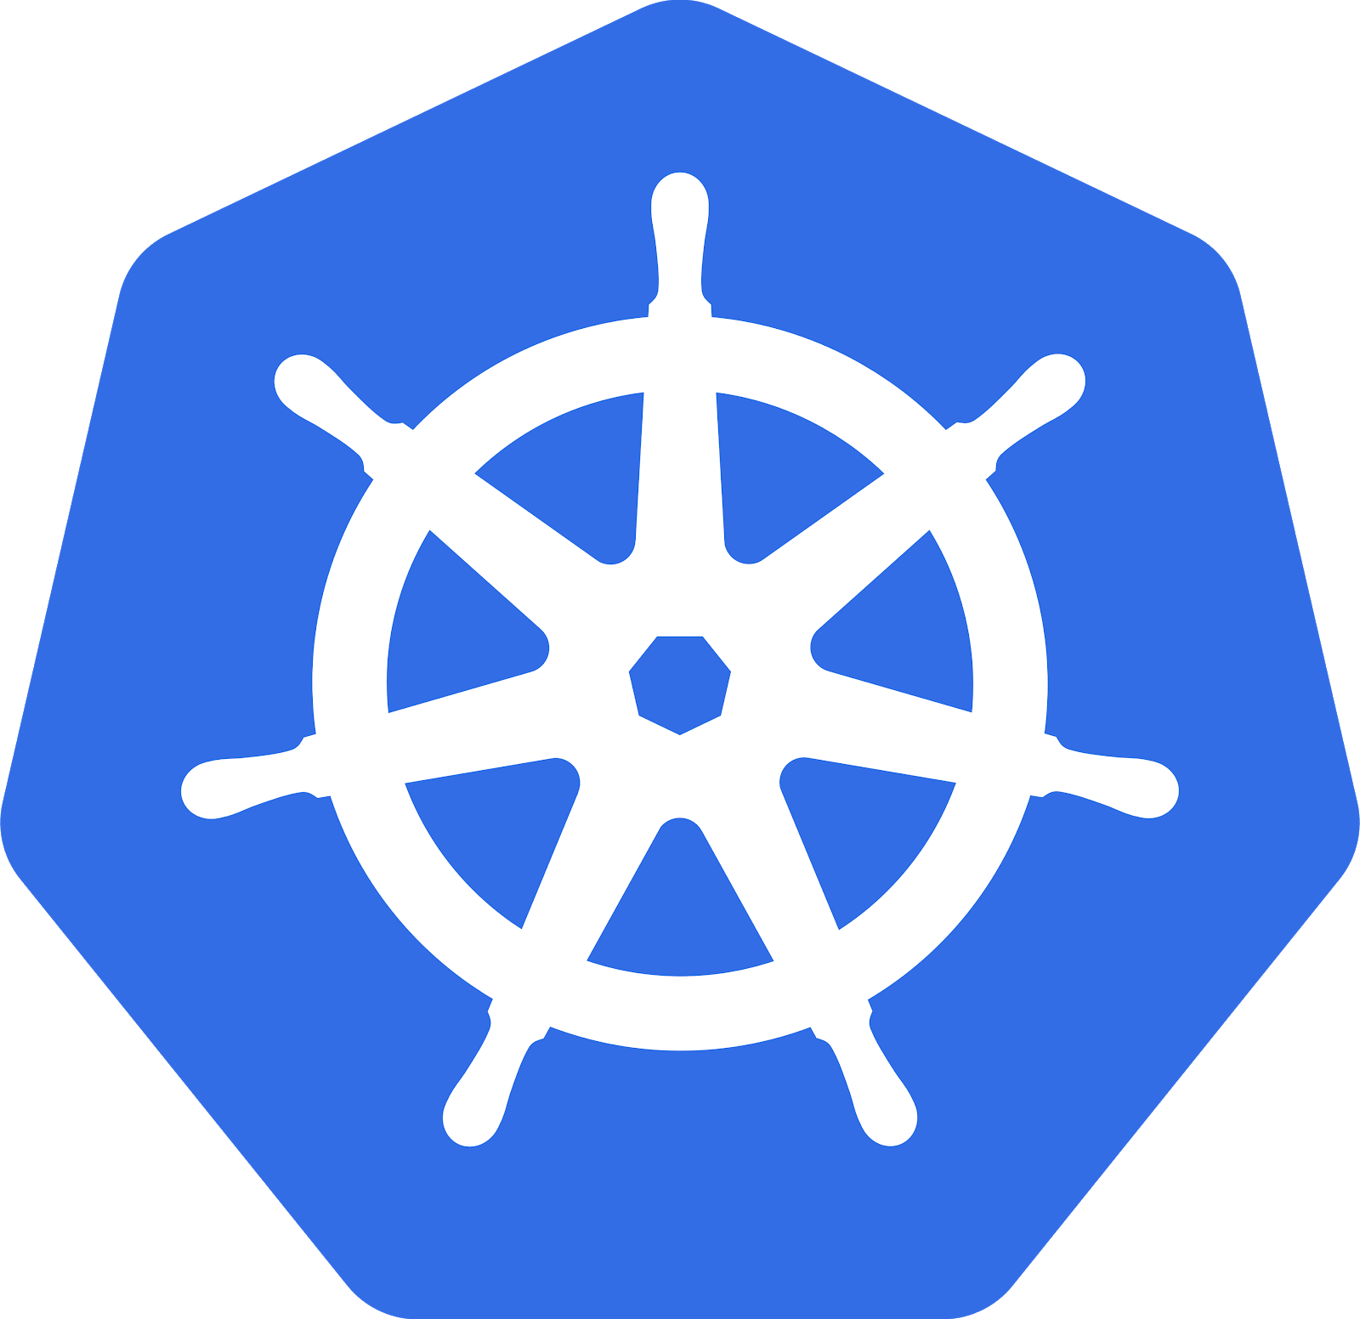

WHAT IS AN OPERATOR?
Embed ops knowledge from the experts
Operator v1.1.2
Deployments
StatefulSets
Autoscalers
Secrets
Config maps

Slide 8
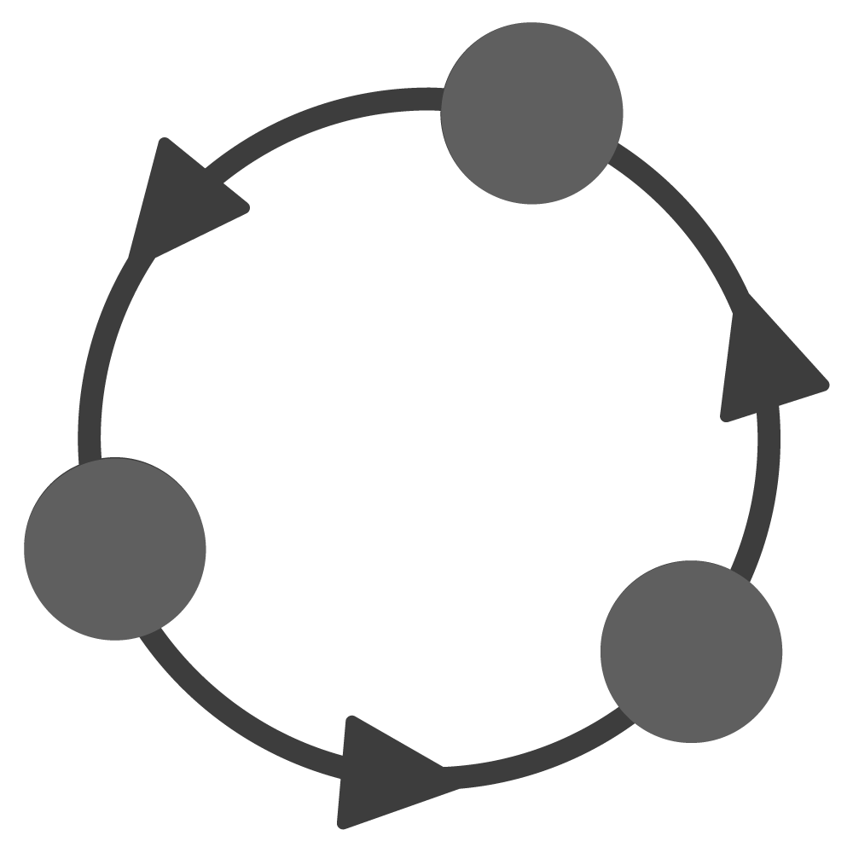
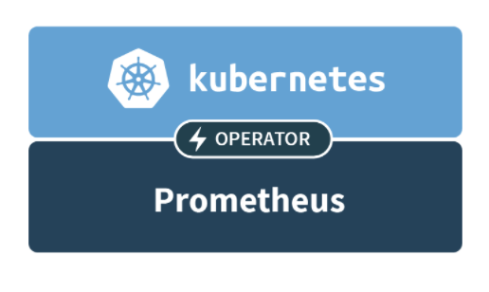

Encoding and automating Ops Knowledge
WITHOUT OPERATORS: REACTIVE
Continually checks for anomalies
Alert humans for response
Requires manual change to fix
WITH OPERATORS: PROACTIVE
Continually adjusts to optimal state Automatically acts in milliseconds

Slide 9

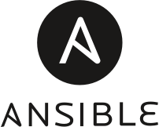

OPERATOR MATURITY MODEL
Phase I
Phase II
Phase III
Phase IV
Phase V
Basic Install
Automated application provisioning and configuration management
Seamless Upgrades
Patch and minor version upgrades supported
Full Lifecycle
App lifecycle, storage lifecycle (backup, failure recovery)
Deep Insights
Metrics, alerts, log processing and workload analysis
Auto Pilot
Horizontal/vertical scaling, auto config tuning, abnormal detection, scheduling tuning

Slide 10
OPERATOR SDK
Helm SDK
Ansible SDK
Go SDK
“No code” Operator
Perfect for Ops
Full power & features
“No code” improvements to Helm SDK user experience
Testing is extremely important for Operators, we have a testing framework built in
SDK includes a “scorecard” to ensure your Operator is technically correct
Testing framework
Verification & Scorecard
OperatorHub

Slide 11

HELM SDK
Container Build
Tomcat Chart
chart.yaml
Operator Container
v1.2.7 chart
Tomcat Object
apiVersion: apache.org/v1
kind: Tomcat
metadata:
name: prod-1.2.7
Namespace: production
spec:
replicaCount: 10
maxActiveSessions: 1000
Running Operator
v1.2.7
$ oc get Tomcats --all-namespaces
NAMESPACE NAME READY STATUS RESTARTS AGE
production prod-1.2.7 1/1 Running 0 4d
staging staging-v1.2.8 1/1 Running 1 2h

Slide 12
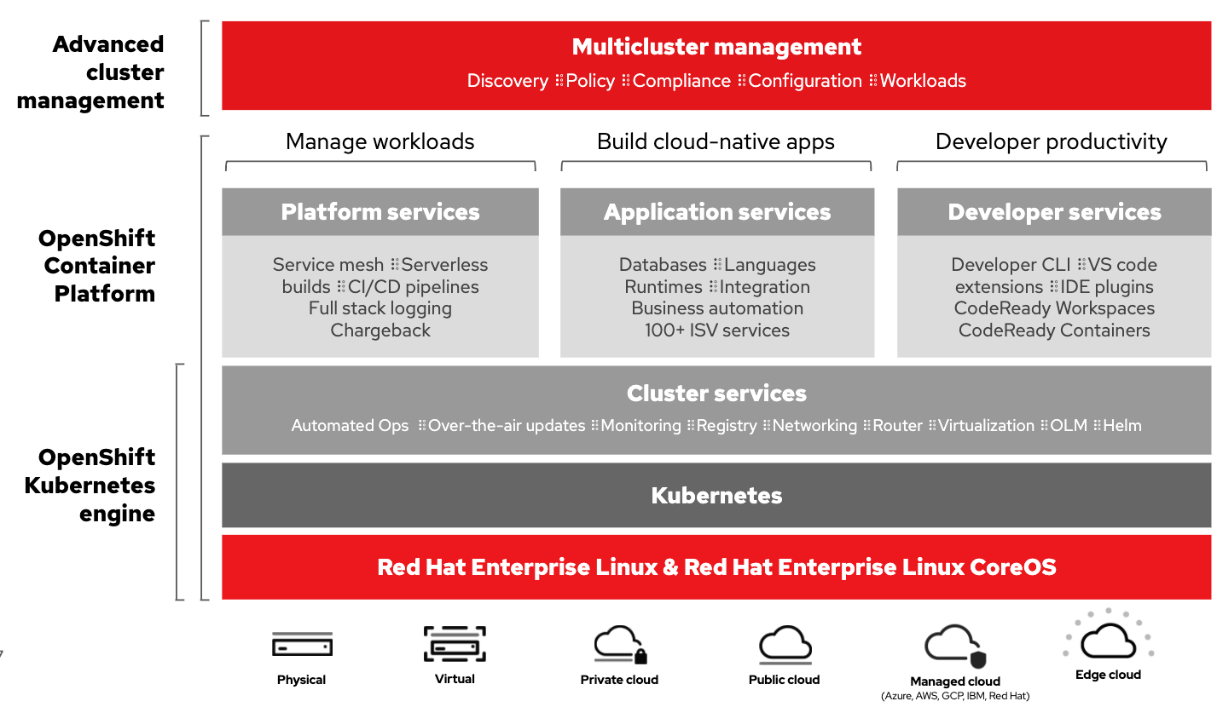
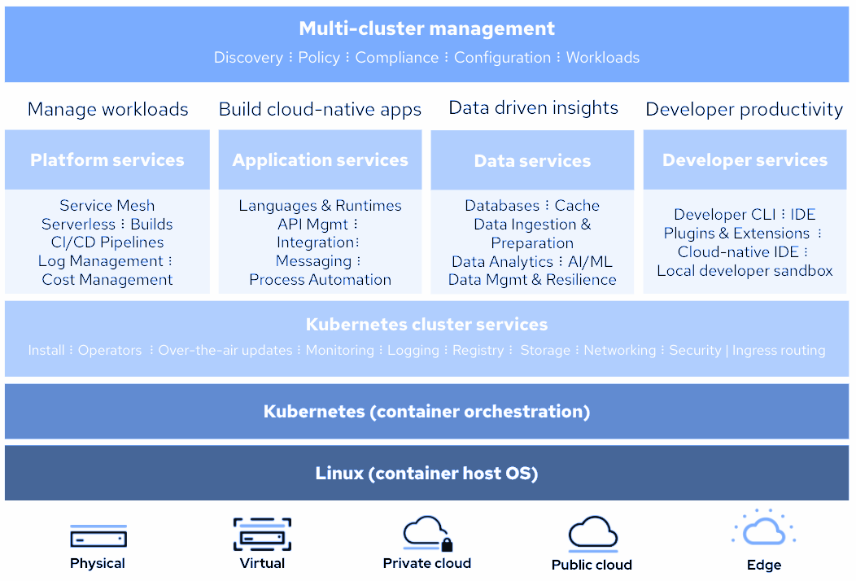
OpenShift Container Platform 4
A smarter Kubernetes platform
Automated, full-stack installation from the container host to application services
Seamless Kubernetes deployment to any cloud or on-premises environment
Autoscaling of cloud resources
One-click updates for platform, services, and applications

Slide 13

RED HAT ENTERPRISE LINUX
General Purpose OS
Immutable container host
BENEFITS
• 10+ year enterprise life cycle
• Industry standard security
• High performance on any infrastructure
• Customizable and compatible with wide
ecosystem of partner solutions
• Self-managing, over-the-air updates
• Immutable and tightly integrated with
OpenShift
• Host isolation is enforced via Containers
• Optimized performance on popular
infrastructure
WHEN TO USE
When customization and integration with additional solutions is required
When cloud-native, hands-free operations are a top priority

Slide 14




IMMUTABLE OPERATING SYSTEM FOR CONTAINERS
Red Hat Enterprise Linux CoreOS is versioned with OpenShift
CoreOS is tested and shipped in conjunction with the platform. Red Hat runs thousands of tests against these configurations.
Red Hat Enterprise Linux CoreOS is managed by the cluster
The Operating system is operated as part of the cluster, with the config for components managed by Machine Config Operator:
CRI-O config
Kubelet config
Authorized registries
SSH config
RHEL CoreOS admins are responsible for:
Nothing.
v4.1.6
v4.1.6

Slide 15
FULL STACK AUTOMATED DEPLOYMENTS
Day 1: OpenShift install - Day 2: Operators
User managed
Control Plane
Worker Nodes
Installer/Operator managed
Red Hat OpenShift Container Platform cluster services
Red Hat OpenShift Container Platform cluster
openshift-install
Red Hat Enterprise Linux CoreOS
Red Hat Enterprise Linux CoreOS
Cloud resources
Cloud resources

Slide 16
DEPLOY TO PRE-EXISTING INFRASTRUCTURE
Day 1: OpenShift install - Day 2: Operators + Customer Managed Nodes & Infra
User managed
Control Plane
Worker Nodes
Installer/Operator managed
Red Hat OpenShift Container Platform cluster services
openshift-install
Red Hat OpenShift Container Platform cluster
Red Hat Enterprise Linux CoreOS
Red Hat Enterprise Linux /
RHEL CoreOS
Customer deployed
Cloud resources
Cloud resources

Slide 17















CONTAINER-NATIVE STORAGE
OPENSHIFT NODE 1
APP CONTAINER
Co-Locate Storage and Apps
OPENSHIFT NODE 2
OPENSHIFT NODE 3
APP Container
APP Container
Dynamic Provisioning
MASTER
RHGS Container
RHGS Container
Managed by OpenShift
Infrastructure-Agnostic
RHGS Container
OPENSHIFT NODE 4

Slide 18
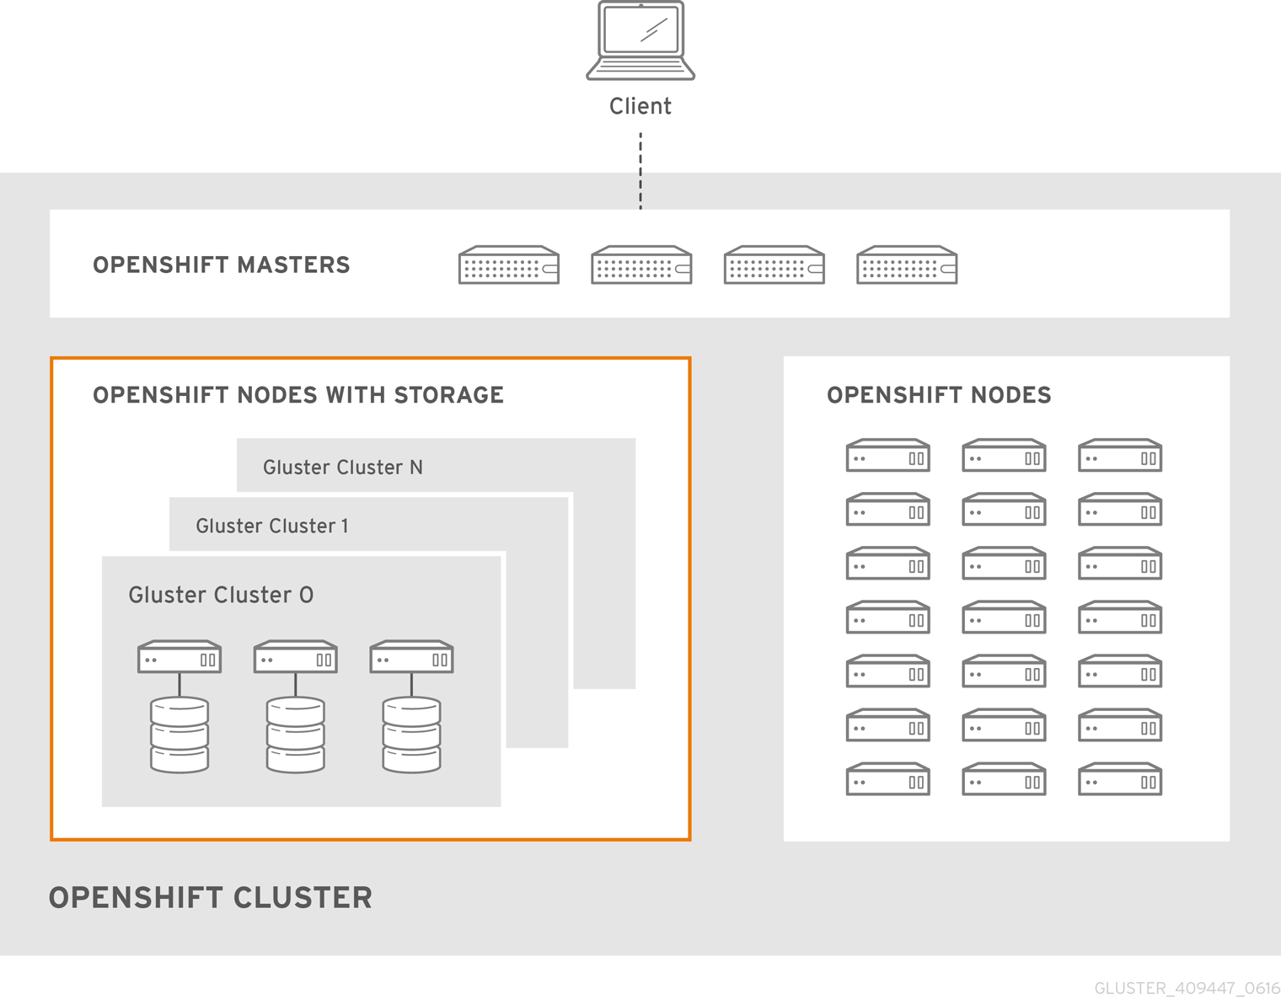
CNS - SUMMARY
With Container-native Storage
Scalable
(1000+ volumes)
Automated
(Dynamic Provisioning)
Highly-Available
(across availability zones)
Integrated
(installs with / runs on OpenShift)
Persistent, resilient and elastic storage...
… that travels with the platform.

